Slide 1
Internship in Java Development
By: Ishan Kansara (D21IT176)

Slide 2
Abstract:
In this Report, we present design and implementation of the project “Employee registration Page”. Employee registration page is commonly use in every company, so it is basic requirement for every company to have this page in their website. We have implemented this with frontend as well as backend. Objective of this project is to give real-time registration experience to people on computer devices.

Slide 3
What is Java Development?
Java is a general-purpose, class-based, object-oriented programming language designed for having lesser implementation dependencies. It is a computing platform for application development. Java is fast, secure, and reliable, therefore. It is widely used for developing Java applications
Java was developed by Sun Microsystems (which is now the subsidiary of Oracle) in the year 1995. James Gosling is known as the father of Java. Before Java, its name was Oak. Since Oak was already a registered company, so James Gosling and his team changed the name from Oak to Java.
Desktop Applications such as acrobat reader, media player, antivirus, etc.
Web Applications such as irctc.co.in, javatpoint.com, etc.
Enterprise Applications such as banking applications.

Slide 4
Tools used during my Internship Program
Apache NetBeans IDE
JDK (Java Development Kit) 17
My Sql 8
Apache Tomcat Server

Slide 5
Technologies Used:
HTML and CSS
Bootstrap
Javascript
Java Server Pages

Slide 6
Servlets in Java
Servlet is a Java Program which has web server properties that runs on a server and capable of handling request and generating dynamic response.
Servlet technology is used to create web applications servlets has capability of web server and responses to the requests.
Servlets Types:
There are Two types of Servlet
Generic Servlet and HTTP Servlet.

Slide 7
Java Database Connectivity (JDBC)
Java™ database connectivity (JDBC) is the JavaSoft specification of a standard application programming interface (API) that allows Java programs to access database management systems. It is a Standard API provided by Oracle for Java Application to interact with different set of databases.
Prerequisites:
Java JDK
Database: Oracle,Mysql etc…
JDBC- Connector

Slide 8
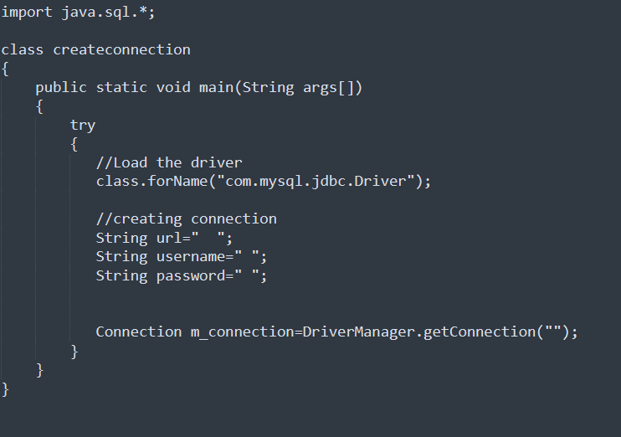
Creating a Connection

Slide 9
Conclusion:
In a nutshell, this internship has been an excellent and rewarding experience. I can conclude that there have been a lot I’ve learnt from my work at Aark Infosoft. Needless to say, the technical aspects of the work I’ve done are not flawless and could be improved provided enough time. As someone with no prior experience with JDBC whatsoever I believe my time spent in research and discovering it was well worth it and contributed to finding an acceptable solution to build a fully functional web service. Two main things that I’ve learned the importance of are time-management skills and self-motivation.

Slide 10
ThankYou

